Slide 1
Implementing Data Visualizations
Notes:
Last class, we learned about the different components in data visualizations and principles in data visualizations that we should be aware of.
With these knowledge, I am sure we can understand what are good, effective, and pleasing visualizations and what are bad visualizations.
In this following two classes, we will do the hands-on coding tasks on how to implement these visualizations.

Slide 2
Questions about what we have learned?

Slide 3
Learning Goals
Understand different types of visualization
Implementing our first visualization

Slide 4
Directory of visualizations
Amounts
Distributions
Proportions
X-y relationships
Geospatial data
Uncertainty
Notes:
Basically, the visualization types can be categorized into the following categories. We might not have time to implement all of these, but what we learn we provide a foundations for implementing others.

Slide 5
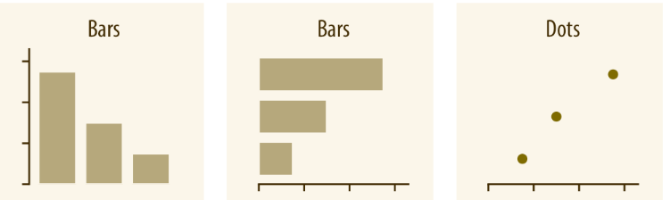
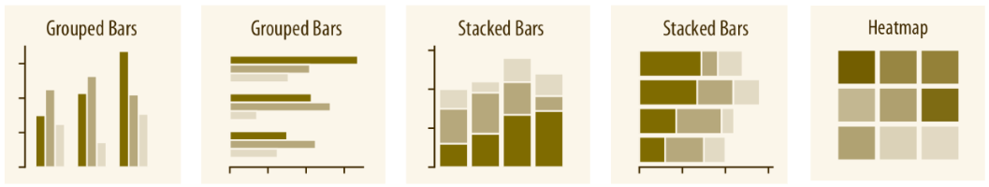
Amounts
Visualizing amounts from one category
Visualizing amounts from multiple categories
Notes:
The most common approach to visualizing amounts (i.e., numerical values shown for some set of categories) is using bars, either vertically or horizontally arranged (Chapter 6). However, instead of using bars, we can also place dots at the location where the corresponding bar would end (Chapter 6).
If there are two or more sets of categories for which we want to show amounts, we can group or stack the bars (Chapter 6). We can also map the categories onto the x and y axis and show amounts by color, via a heatmap (Chapter 6).

Slide 6
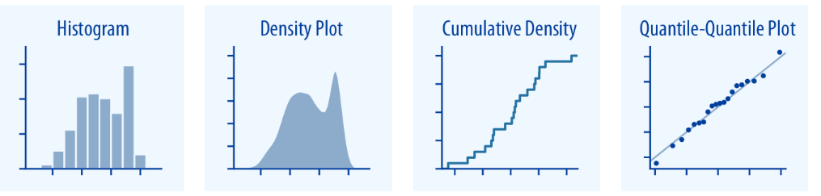
Distributions
Visualizing one distribution
Intuitive but require arbitrary parameter choices and can be misleading
Cumulative densities and quantile-quantile (q-q) plots represent the data faithfully but difficult to interpret
Notes:
There are two categories of distributions.

Slide 7
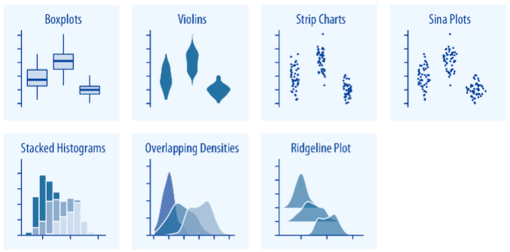
Distributions
Visualizing multiple distribution
Overall shifts among distributions in multiple distributions
Stacked plot and overlapping densities are useful for in-depth comparison of smaller number of distributions
Ridgeline plots are useful for large numbers of distributions
Notes:
Boxplots, violins, strip charts, and sina plots are useful when we want to visualize many distributions at once and/or if we are primarily interested in overall shifts among the distributions
Stacked histograms and overlapping densities allow a more in-depth comparison of a smaller number of distributions, though stacked histograms can be difficult to interpret and are best avoided
Ridgeline plots can be a useful alternative to violin plots and are often useful when visualizing very large numbers of distributions or changes in distributions over time

Slide 8
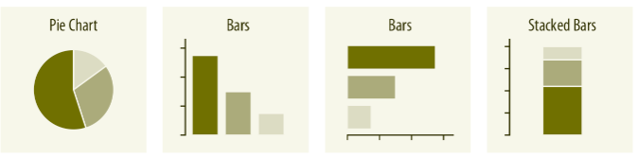
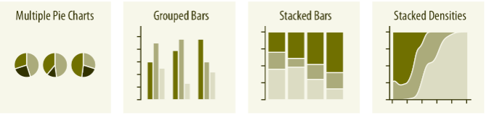
Proportions
Single set of proportion
Multiple sets of proportions
Notes:
Proportions can be visualized as pie charts, side-by-side bars, or stacked bars.
Pie charts emphasize that the individual parts add up to a whole and highlight simple fractions.
However, the individual pieces are more easily to be compared by bar charts.
Stacked bars are awkward for a single set of proportions but can be useful for comparing multiple sets of proportions.
When visualizing multiple changes in proportions across conditions, pie charts tend to be space-inefficient and often obscure relationships.
Grouped bars work well as long as the number of conditions compared is moderate, and stacked bars can work for large numbers of conditions.
Stacked densities are appropriate when the proportions change along a continuous variable.

Slide 9
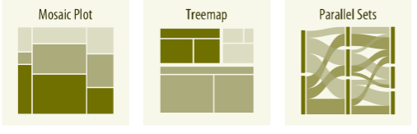
Distributions
Mosaic plots assume that every level of one grouping variable can be combined with every level of another grouping variable, whereas treemaps do not make such an assumption.
Treemaps work well even if the subdivisions of one group are entirely distinct from the subdivisions of another.
Parallel sets work better than either mosaic plots or treemaps when there are more than two grouping variables.
Notes:
When proportions are specified according to multiple grouping variables, then mosaic plots, treemaps, or parallel sets are useful visualization approaches

Slide 10
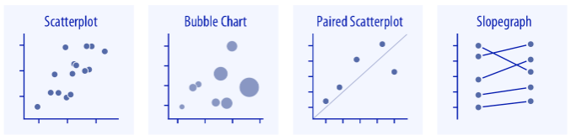
X–y relationships
Relationships between two variables
Mapping one variable into size with three variables
X, y variables are measured with the same units
X, y variables connected by straight lines
Notes:
Scatterplots represent the visualization when we want to show one quantitative variable relative to another.
If we have three quantitative variables, we can map one onto the dot size, creating a variant of the scatterplot called bubble chart.
For paired data, where the variables along the x and the y axes are measured in the same units, it is generally helpful to add a line indicating x = y.
Paired data can also be shown as a slope graph of paired points connected by straight lines.

Slide 11
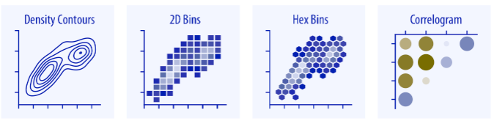
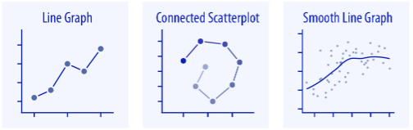
X–y relationships
Notes:
For large numbers of points, regular scatterplots can become uninformative due to overplotting. In this case, contour lines, 2D bins, or hex bins may provide an alternative.
When we want to visualize more than two quantities, on the other hand, we may choose to plot correlation coefficients in the form of a correlogram instead of the underlying raw data
When the x axis represents time or a strictly increasing quantity such as a treatment dose, we commonly draw line graphs (Chapter 13). If we have a temporal sequence of two response variables, we can draw a connected scatterplot where we first plot the two response variables in a scatterplot and then connect dots corresponding to adjacent time points (Chapter 13.3). We can use smooth lines to represent trends in a larger dataset (Chapter 14).

Slide 12
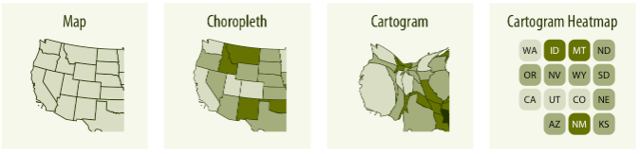
Geospatial data
Notes:
The primary mode of showing geospatial data is in the form of a map. A map takes coordinates on the globe and projects them onto a flat surface, such that shapes and distances on the globe are approximately represented by shapes and distances in the 2D representation.
In addition, we can show data values in different regions by coloring those regions in the map according to the data. Such a map is called a choropleth (Chapter 15.3). In some cases, it may be helpful to distort the different regions according to some other quantity (e.g., population number) or simplify each region into a square. Such visualizations are called cartograms.

Slide 13
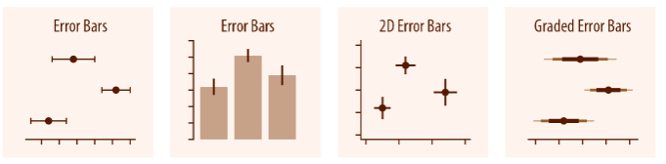
Uncertainty
Error bars are graphical representations of variability of data and used on graphs to indicate the error or uncertainty in a reported measurement.
Error bars often represent one standard deviation of uncertainty, one standard error, or a particular confidence interval.
A short Error Bar shows that values are concentrated, a long Error Bar would indicate that the values are more spread out and less reliable
Notes:
Error bars are meant to indicate the range of likely values for some estimate or measurement. They extend horizontally and/or vertically from some reference point representing the estimate or measurement.
Reference points can be shown in various ways, such as by dots or by bars.
Graded error bars show multiple ranges at the same time, where each range corresponds to a different degree of confidence.
The length of an Error Bar helps reveal the uncertainty of a data point: a short Error Bar shows that values are concentrated, signalling that the plotted average value is more likely, while a long Error Bar would indicate that the values are more spread out and less reliable.
Also depending on the type of data, the length of each pair of Error Bars tend to be of equal length on both sides. However, if the data is skewed, then the lengths on each side would be unbalanced.

Slide 14
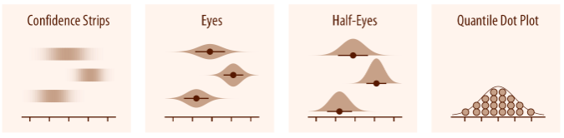
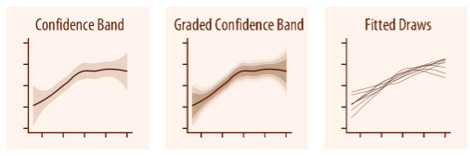
Uncertainty
Notes:
To achieve a more detailed visualization, we can visualize the actual confidence or posterior distributions.
Confidence strips provide a clear visual sense of uncertainty but are difficult to read accurately.
Eyes and half-eyes combine error bars with approaches to visualize distributions (violins and ridgelines, respectively), and thus show both precise ranges for some confidence levels and the overall uncertainty distribution.
A quantile dot plot can serve as an alternative visualization of an uncertainty distribution. By showing the distribution in discrete units, the quantile dot plot is not as precise but can be easier to read than the continuous distribution shown by a violin or ridgeline plot.
For smooth line graphs, the equivalent of an error bar is a confidence band. It shows a range of values the line might pass through at a given confidence level. As in the case of error bars, we can draw graded confidence bands that show multiple confidence levels at once. We can also show individual fitted draws in lieu of or in addition to the confidence bands.

Slide 15
Visualization Packages

Slide 16

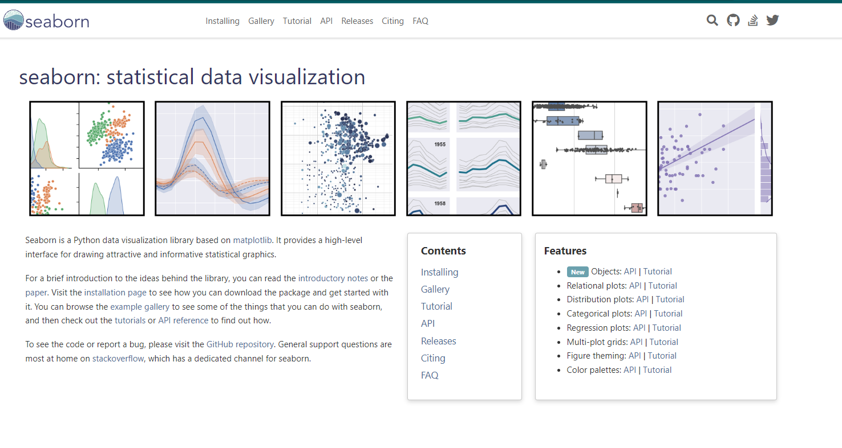
Matplotlib VS Seaborn

Slide 17
Visualizing Amounts
In many scenarios, we are interested in the magnitude of some set of numbers. These scenarios always include qualitative categories and associated quantitative values for each category. The visualization strategies include Simple bar chart, grouped bar chart, stacked bar chart, dot plot and heatmap.
Notes:
In the following, we will discuss how to implement these bar charts with python with the data the real contexts.
During this process, I hope we can get a whole understanding and manipulate each element in the figure with code.

Slide 18
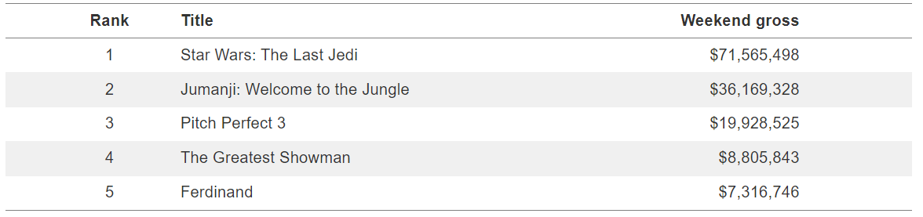
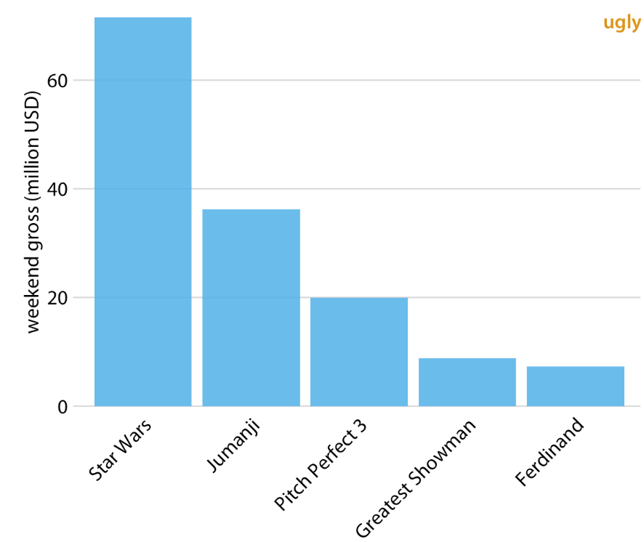
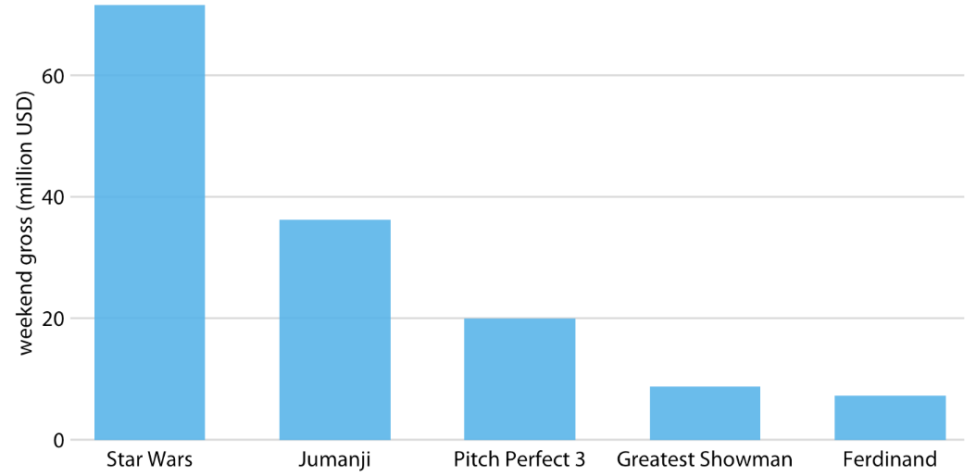
Simple Bar plots
Highest grossing movies for the weekend of December 22-24, 2017.
Take up too much horizontal space
Notes:
For example, this table shows the dataset about the highest grossing movies for the weekend of December 22-24, 2017. We use vertical bar plot to visualize the dataset. One problem of this visualization is that the labels take up too much horizontal space. One solution is to increase the width of the figure and spaces between bars.

Slide 19
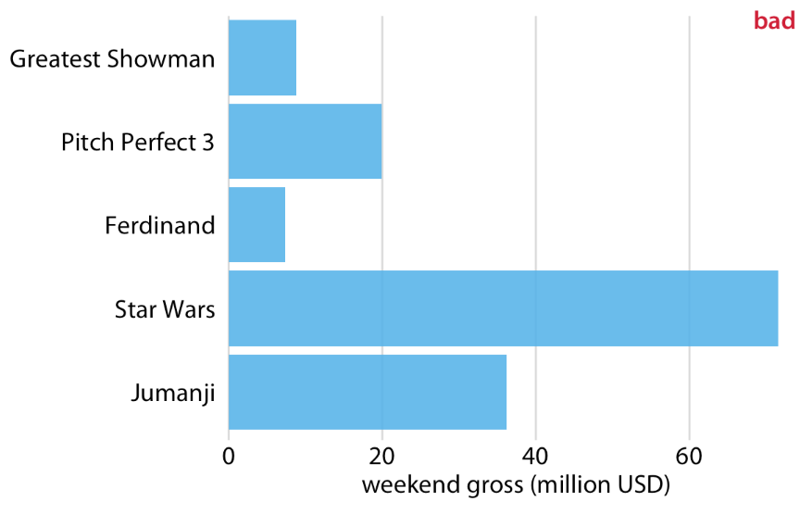
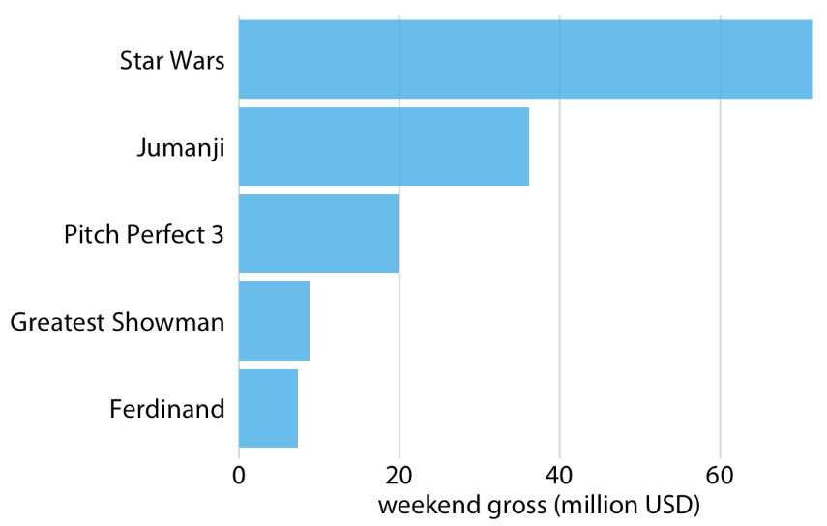
Horizontal bar charts
Simple Bar plots
Order matters
Notes:
Another solution is to change the vertical bar chart into the horizontal bar chart. Moreover, we need to pay attention to the order in which the bars are arranged.

Slide 20
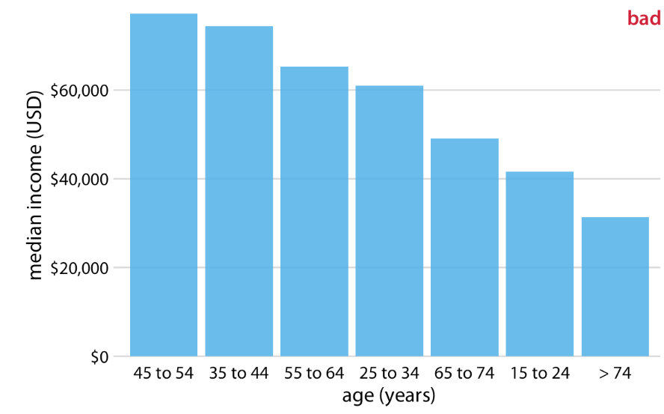
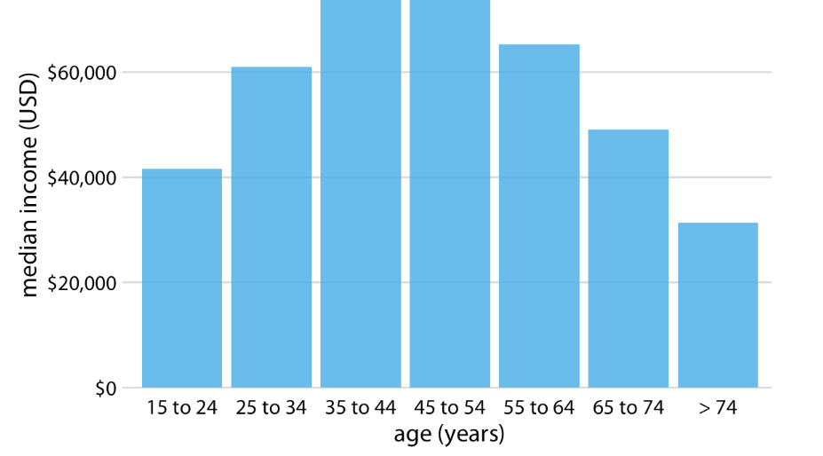
Another example
Simple Bar plots
Pay attention to the bar order. If the bars represent unordered categories, order them by ascending or descending data values.
2016 median U.S. annual household income versus age group.
Notes:
But when we compare the differences in median household income across different age groups. This visualization is bad.
It is because the categories have an order.
Pay attention to the bar order. If the bars represent unordered categories, order them by ascending or descending data values.

Slide 21
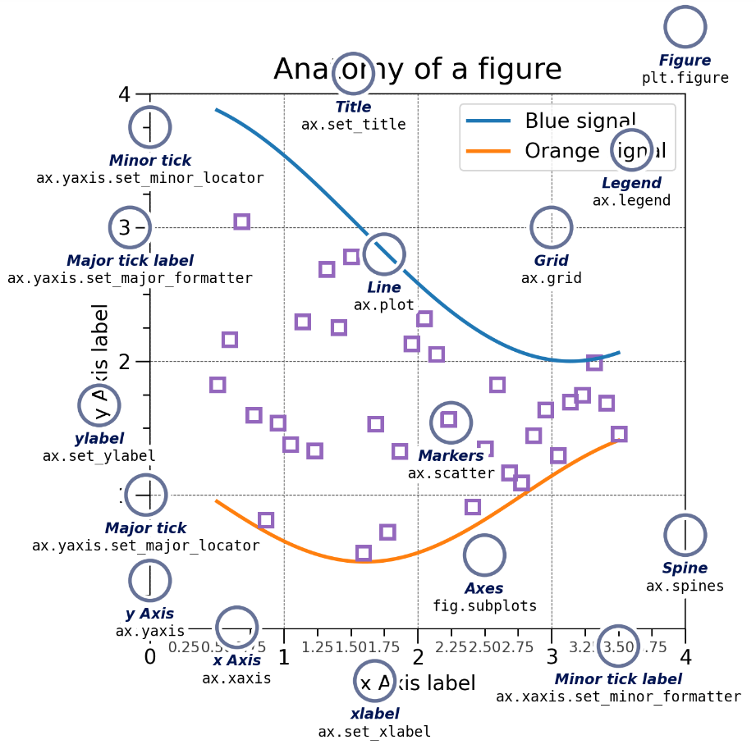
Parts of a Figure in Matplotlib
Matplotlib graphs your data on Figures (e.g., windows, Jupyter widgets, etc.), each of which can contain one or more Axes, an area where points can be specified in terms of x-y coordinates (or theta-r in a polar plot, x-y-z in a 3D plot, etc.). The simplest way of creating a Figure with an Axes is using pyplot.subplots. We can then use Axes.plot to draw some data on the Axe.
Notes:
Implementation of bar chart is very simple, but there is a lot of small aspects small taking up so much time when we tweak them.
Such as how can we:
rotate those ticklabels,
how can we place each bar
and any other aspects in the figure.
Matplotlib package is not of the most popular packages used in scientific visualizations.
With this operation, we can manipulate every aspect in a figure.

Slide 22
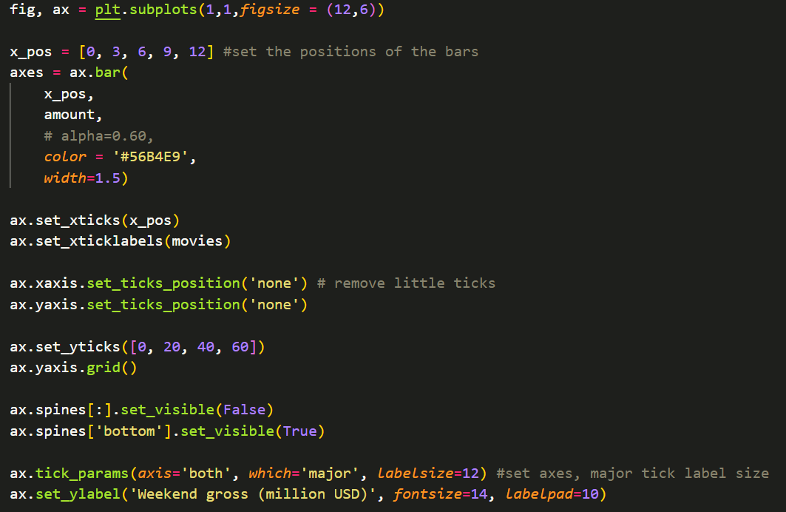
How to implement?
Plot the figure
Format the figure
Notes:
ax.xaxis.set_ticklabels(movies,rotation=10)

Slide 23
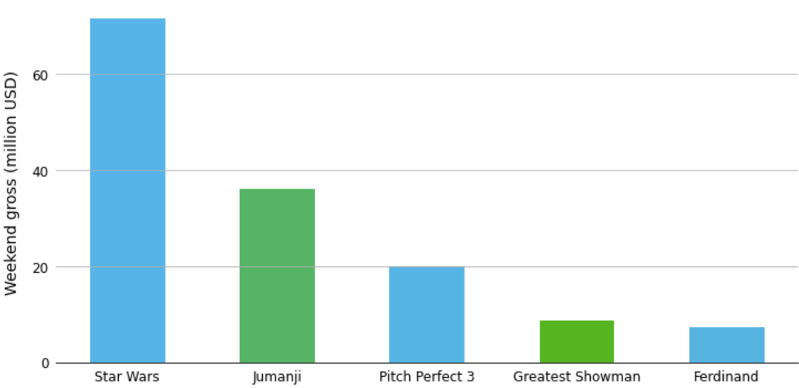
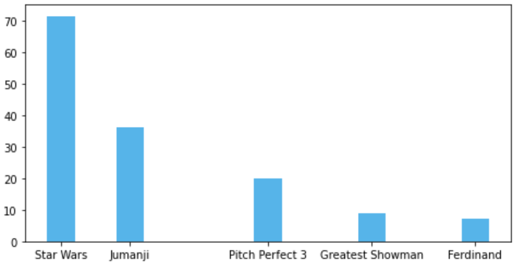
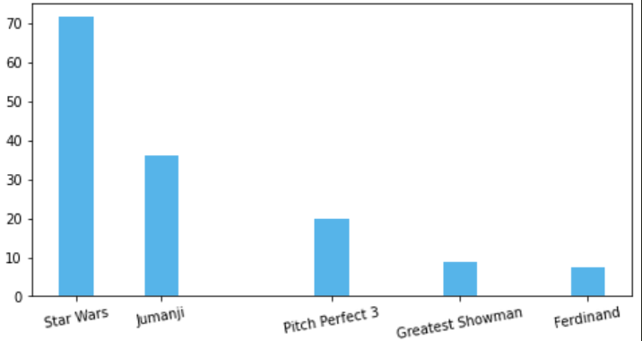
Can you implement?

Slide 24
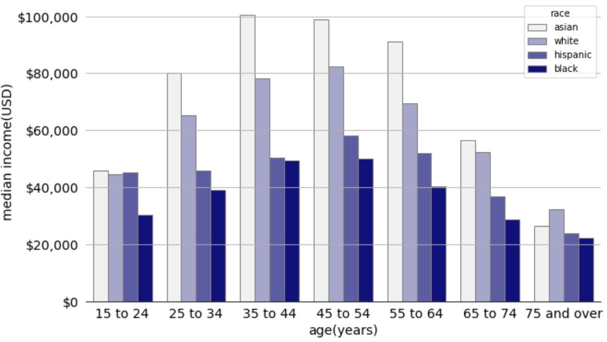
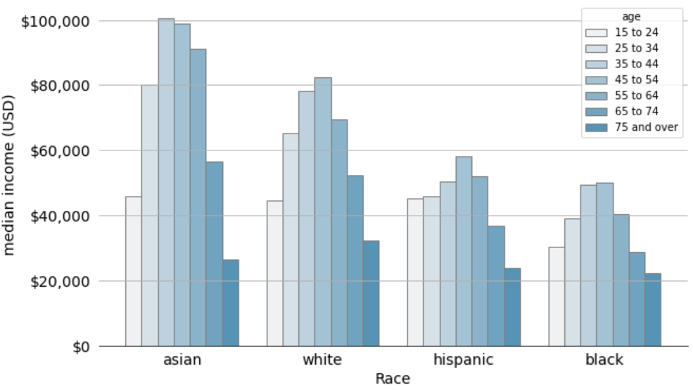
Grouped Bar Chart
The differences in annual household income versus age and race
Notes:
Instead of visualizing amount of data from a single category. We can visualize and compare data from multiple categories at the same time.
In a grouped bar plot, we draw a group of bars at each position along the x axis, determined by one categorical variable, and then we draw bars within each group according to the other categorical variable.
So this figure is only appropriate if we are primarily interested in the differences in income levels among racial groups, separately for specific age groups.
If we care more about the overall pattern of income levels among racial groups, it may be preferable to show race along the x axis and show ages as distinct bars within each racial group

Slide 25
Any problems with the figures?

Slide 26
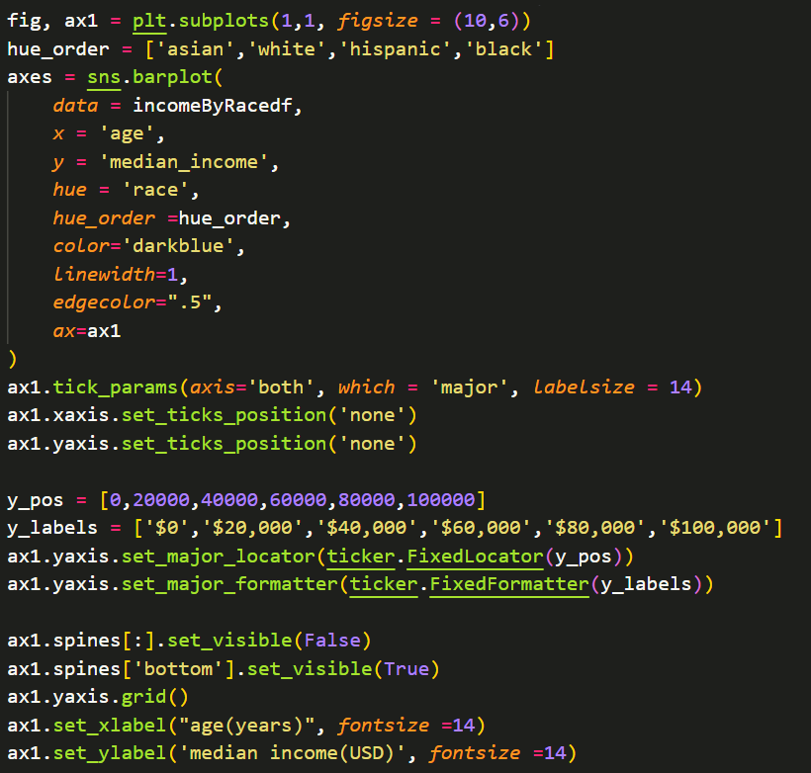
How to implement?
Aspects we might need to pay attention:
How to order the categories at different levels
How to customize the ticklabels

Slide 27
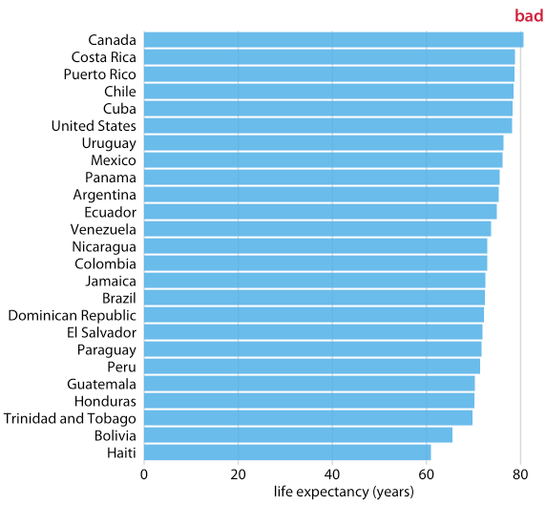
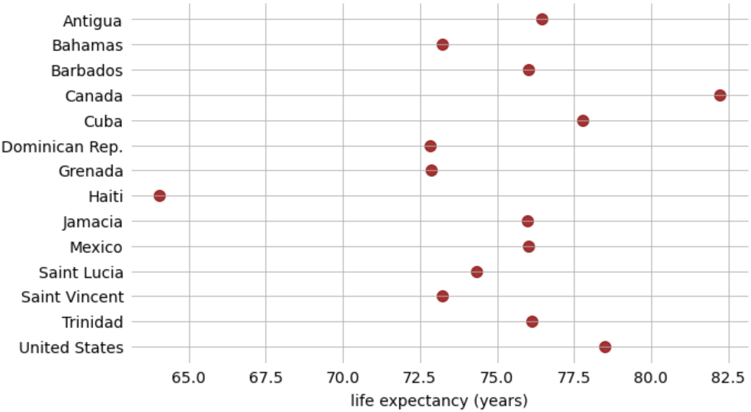
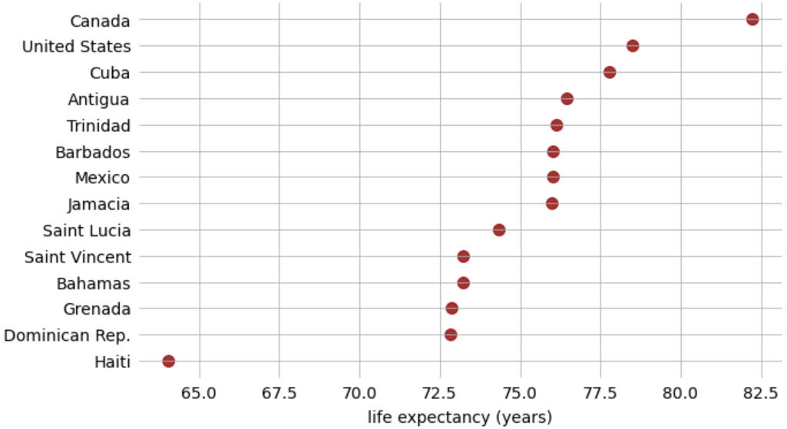
Dot plots and heatmaps
Life expectancies of countries in the Americas, for the year 2007.
Notes:
As we talked in our last class, it is better for bars to start at 0 so that the length of the bars are proportionately to the amount we show. But always beginning at 0, it is sometimes impractical. There are some other alternative approaches. In this case, we can indicate amounts by placing dots at the appropriate locations along the x or y axis

Slide 28
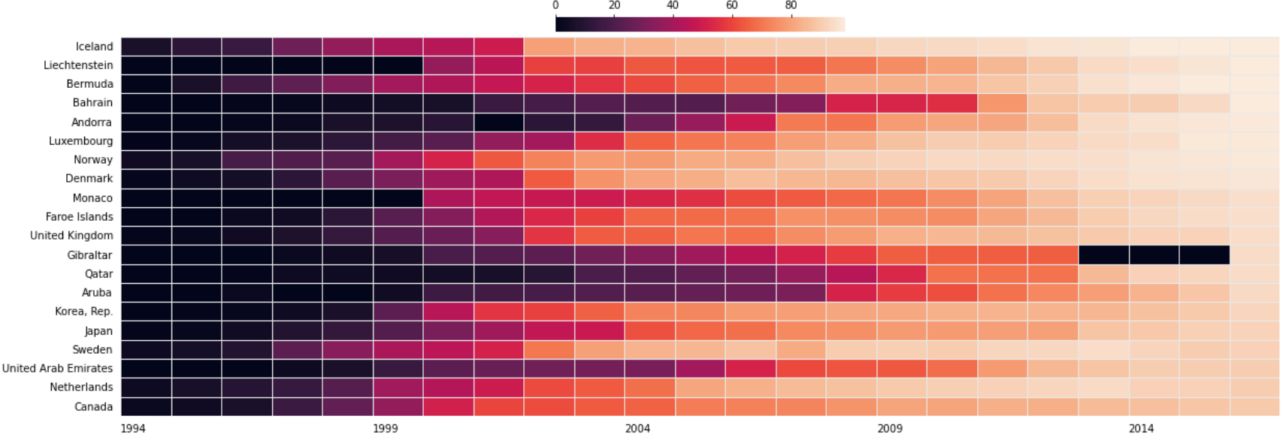
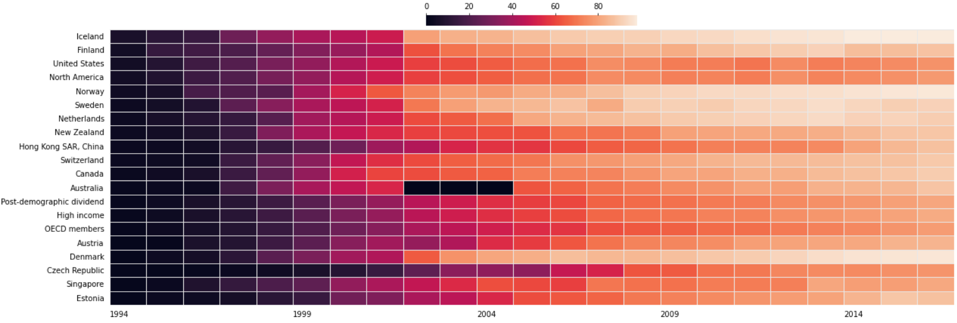
Heatmap
Sorted based on the data in the year 2016
Sorted based on the data in the year 1994
Notes:
As an alternative to mapping data values onto positions via bars or dots, we can map data values onto colors.
While this visualization makes it harder to determine the exact data values shown (e.g., what’s the exact percentage of internet users in the United States in 2015?), it does an excellent job of highlighting broader trends. We can see clearly in which countries internet use began early and which it did not, and we can also see clearly which countries have high internet penetration in the final year covered by the dataset (2016

Slide 29
Summary what we have learned?

Slide 30
Additional Practice
With the provided student dataset
Compare the number of male and female students in the course
Compare the average performance across different age groups (age_band in column in the dataset)
Compare the average performance of students of different gender and different region
Compare the average performance of students of different gender and highest education

